Slide 1
Pastry-making cLASS

Slide 2
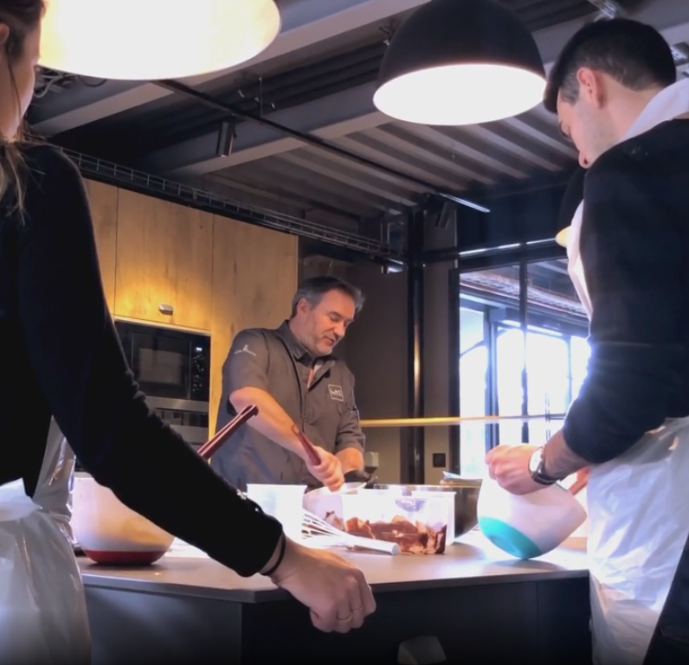
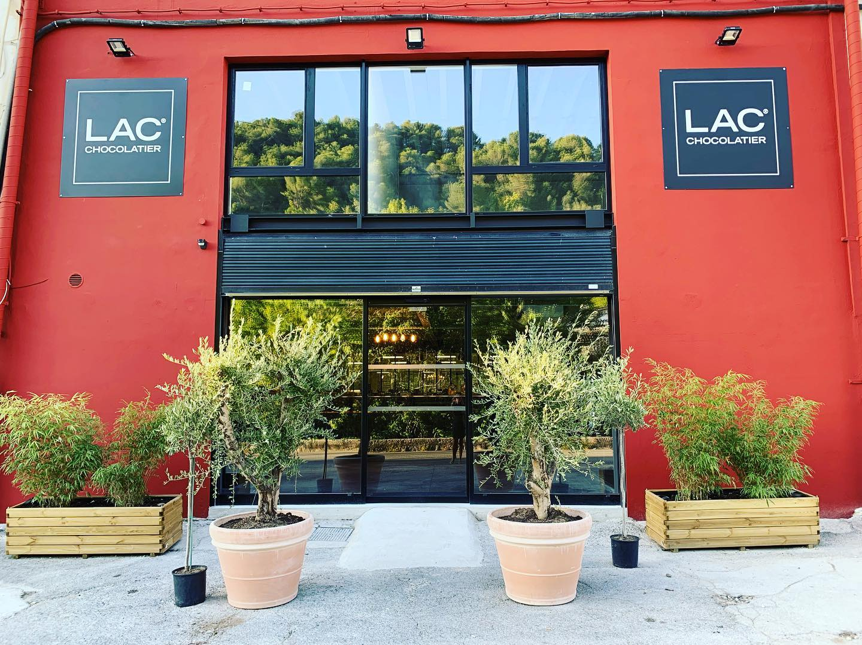
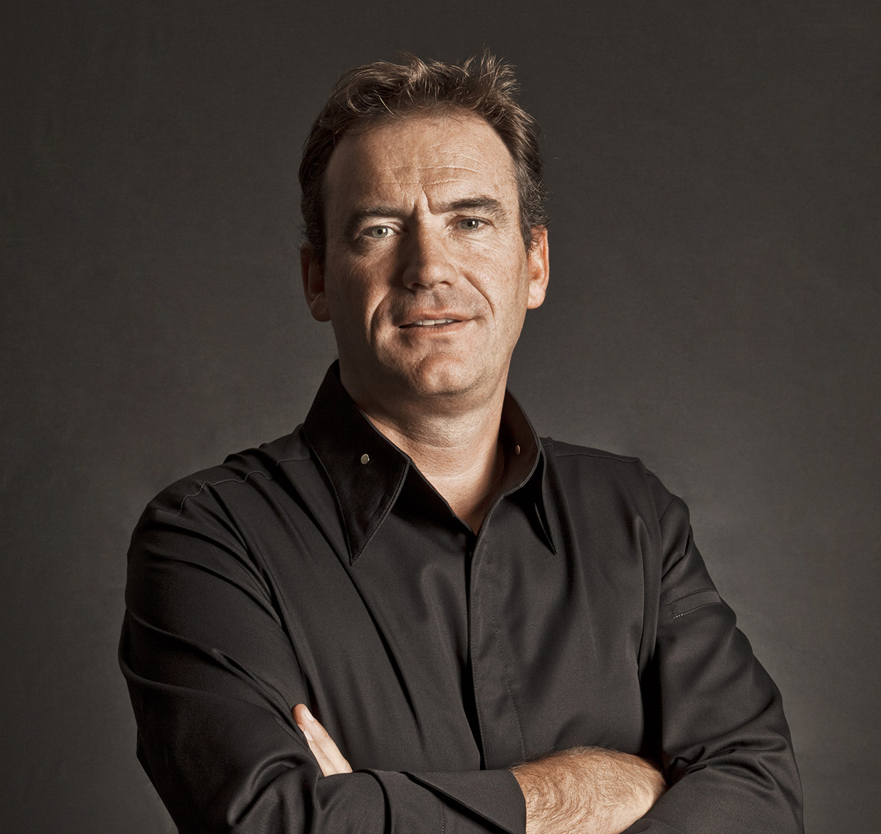
Priority given to employees who never registered to a cooking class.
7 attendees per class - 3-hour class on Saturday
75 euros soit 30 euros après subvention Sofun
LAC La Trinité
113, route de Laghet
06340 La Trinité, France

Slide 3
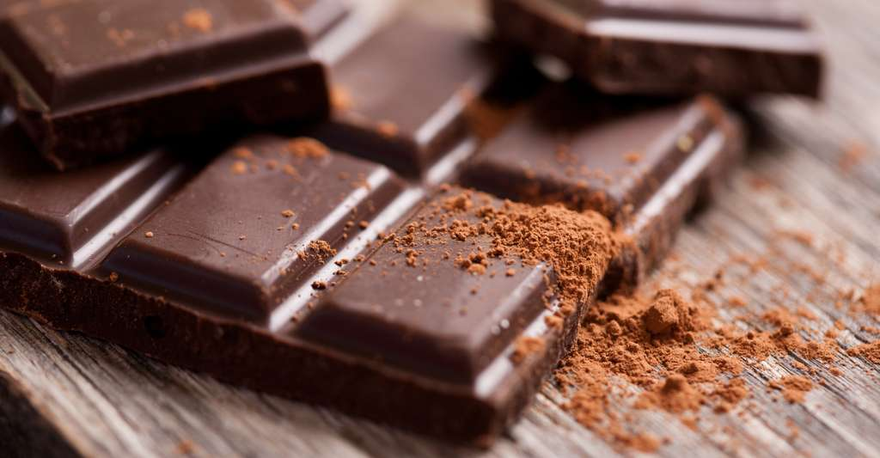
NOT INCLUDED: - Transport
A box of 10 chocolates offered at the end of the class

